Slide 1
Online Job Portal presentation

Slide 2
Introduction
The name of the project is Online Job portal
•
The website provides both the jobseekeers and the recruiters his PIN number which is unique.
•
The main stakeholders of this system are:
1. Recruiting manager.
2. Vacancies
3. Job Seekers.
4. Administrator
•
This system enables the Recruiting manager to login to the system and create a vacancy and post it on the web. The Recruiting manager can associate jobseekers with a vacancy and Schedule the interview. He is able to search on jobseeker number and Vacancy number.

Slide 3
This system enables the jobseekers to login, to view all the vacancies and to view the applicant and vacancy details. He is also able to search on interview date, number and vacancy number.
The Job Seekers can register and create a profile. He/She can search and apply for jobs online. He could view his interview details and application status.
•
•

Slide 4
Project Overview
The requirements are as follows:
Generic:
Login to the system through the first page of the application – the welcome message should display the Name and Employee number of the person.
Change the password after login to the application (optional)
See his/her details and change it.(Optional)
Help from the system
2.Recruiter group:
Should be able to create a new vacancy.
Should be able to change any of the editable details for the
vacancy.
Should be able to search on Applicant Number and Vacancy Number.

Slide 5
. Administrator
a. Should be able to create a new applicant.
Should be able to change any of the editable details for the applicant.
Should be able to search on Applicant
Number and Vacancy Number.
Attach an applicant to a vacancy - The relationship between applicant and vacancy.

Slide 6
Job Seeker:
Should be able to view all vacancies scheduled to be taken.
Should be able to view the details of the
company.
Should be able to view the details of the vacancy.
Should be able to search on vacancies,
Applicant Number and Vacancy Number.

Slide 7
Software and hardware requirement
Hardware Interface :-
The system should have these hardware requirements :
The processor should be at least Pentium 3 or above
The processor speed should be greater than 400Mhz
The video device should support graphics
Ram should be or greater than 120 mb
Software Interfaces :-
The software requires the support of the following soft wares for the database and other requirements
Php and html editor for web interface
Mysql for database
Server(windows 2000,apache or…)

Slide 8
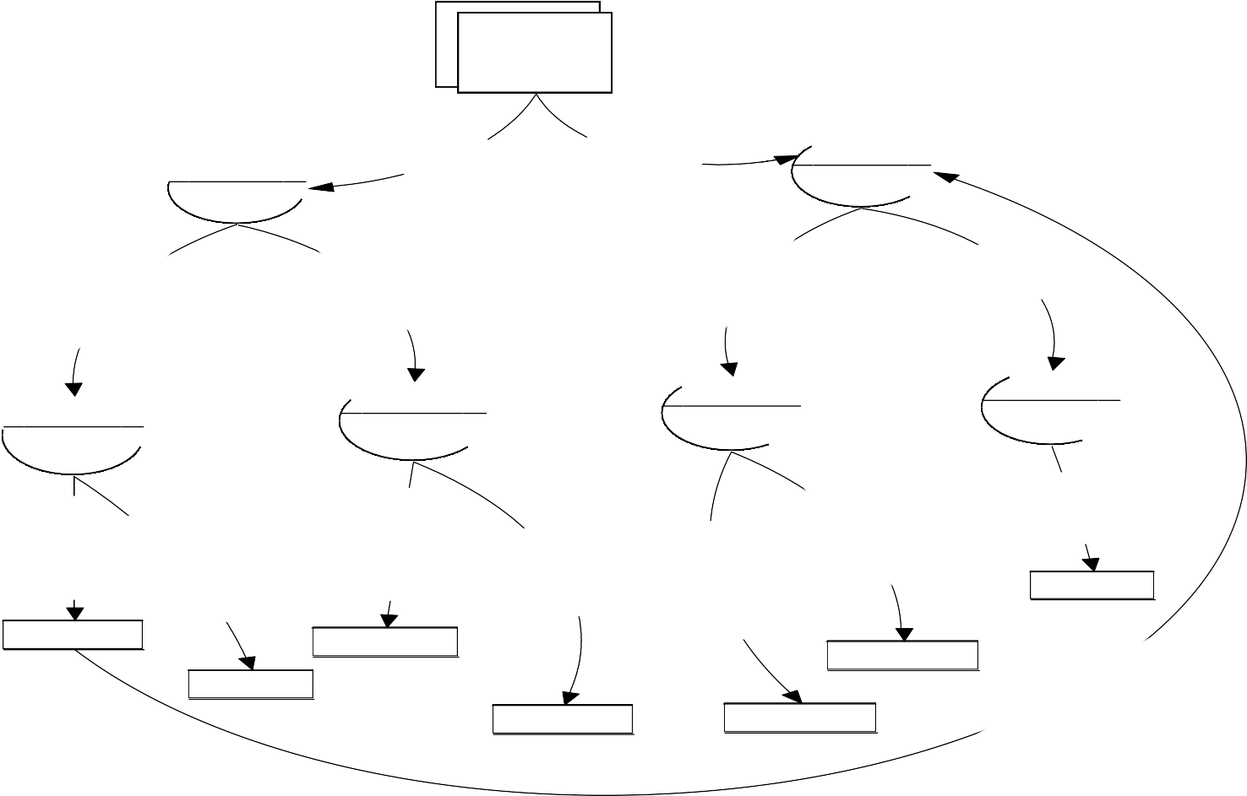
Data Flow Diagram
Job Seeker DFD
Job Seeker
1
Sign UP
New User
Existin User
2
Sign IN
Insert Proffesonal Info.
Update Seeker Acc.
Check Mail
Insert Personal Info.
1.1
Personal Info.
1.2
Proffesio nal Info.
2.1
Update Account
2.2
Mail
Storing Login Info.
Cheking Mail
Storing Qualification
Updating Proffesional Info.
Storing Personal Info.
Storing Job Info.
Udating Personal Info.
job_app
user_login
proffesional_d1
proffesional_d
personal_d
Checking User Name & Password
Proffesional_d
personal_d

Slide 9
Employer DFD
Employer
New Emp. Sign Up
2
Log IN
1
Sign UP
New Jo
Job Mail
Job Seekers
2.1
Udate Acc.
1
User Info.
Company Info.
Putting New Job
2.3
Search Job Seeker
Check Mail
2.2
1.1
1.2
Update Ac count
Seeker Resume
User Info.
Company Details
Posting New Job
Chech Received Mail
Seeker Resume
Update Acc.
Interview for Eligible Candidate
personal_d
Store User Info.
Store Company Info.
job
Store User Position in Org.
Job_app
emp_account
1
emp_account
Interview Schd.
Proffesional_d
comp_acc
Call Interview
emp_personal
job_letter

Slide 10
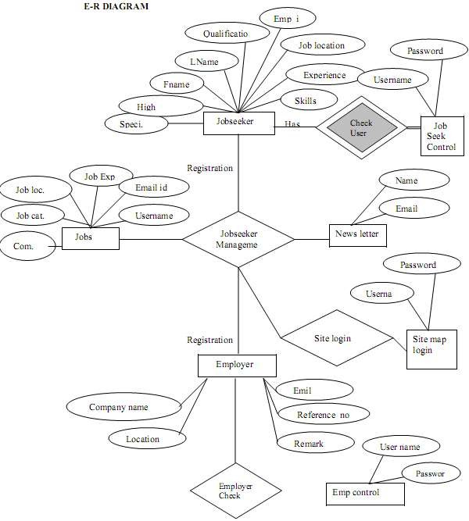
ER diagram

Slide 11
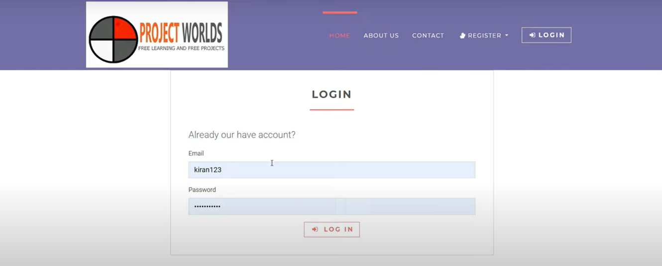
Form Design
1.Login form

Slide 12

2.Search page

Slide 13
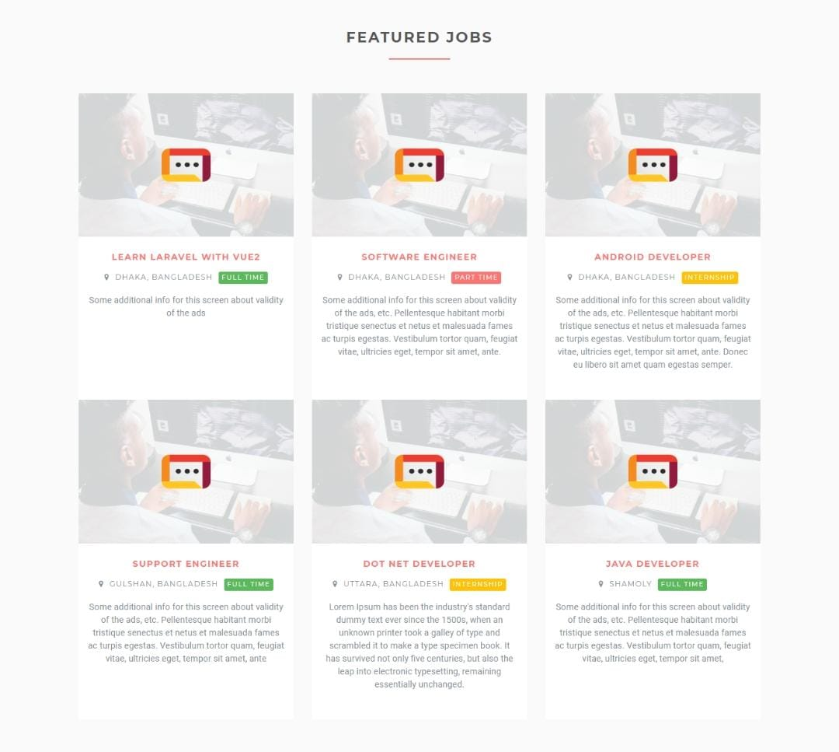
3.Jobs Page

Slide 14

4.Job-Discription

Slide 15
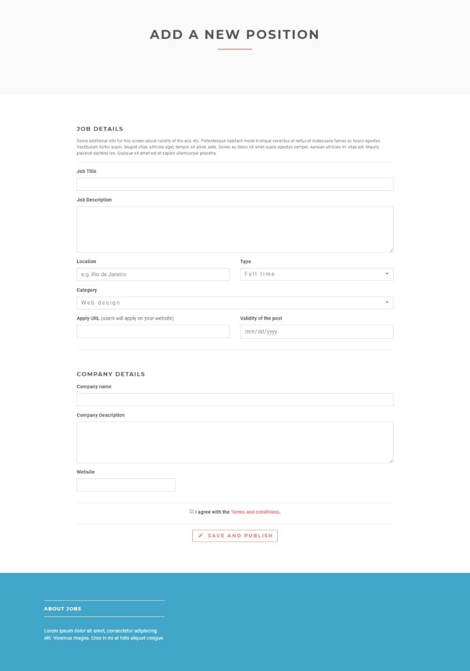
5.New Positon

